Slide 1




Mamba Model vs LSTM: RNNs Comparisons for Stock Trading Predictions

Slide 2



Understanding the Landscape: Stock Market Prediction and Machine Learning
Predicting stock prices : a challenging task due to the inherent complexity and volatility of financial markets.
importance of accurate predictions for traders and investors.
the rise of machine learning techniques in stock market prediction.
the two models: Mamba Model and LSTM networks.
the objective of the presentation: "To compare the effectiveness of Mamba Model and LSTM for stock trading prediction

Slide 3


Mamba Model Overview
Input : (batch_size, sequence_length, 1)
Output : (batch_size, sequence_length, 1)
</Architecture>:
The Mamba Model is composed of multiple layers, each containing Residual Blocks.
</Components>:
Each Residual Block comprises a MambaBlock, normalization, and residual connections.
</Selective Scan>:
The model employs a selective scan mechanism for efficient computation, enhancing performance. (involves performing computations in parallel by selectively processing different segments of input data).
</Innovations>:
The Mamba Model introduces selective scan and utilizes residual connections for improved efficiency and performance in stock market prediction tasks.

Slide 4
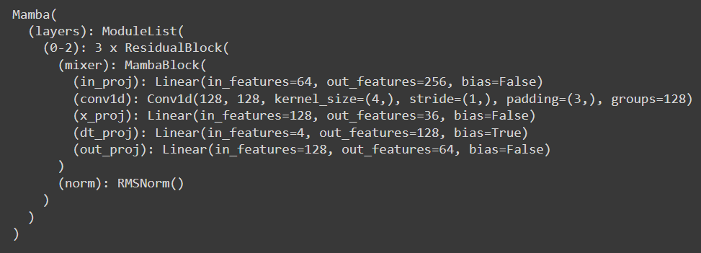
Mamba Model Overview

Slide 5


LSTM Overview
Input : (batch_size, sequence_length, 1))
Output : (batch_size, 1)
</Architecture>:
LSTM is a type of recurrent neural network featuring memory cells with input, forget, and output gates.
</Functionality>:
The model excels in capturing long-term dependencies in sequential data, making it suitable for time-series prediction tasks.
</Key Features>:
its gate mechanisms and memory cells, facilitate the controlled flow of information through the network. Regulating the learning process and capture intricate temporal patterns present in sequential data.
</Relevance>:
Well known in sequential data analysis and prediction, particularly in stock market prediction. Its robust architecture and proven track record make it a benchmark for comparison when evaluating newer models like Mamba.

Slide 6
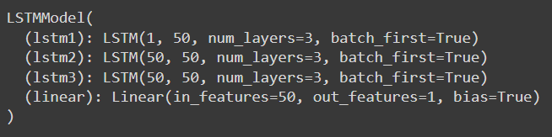
LSTM Overview

Slide 7

Model Comparison
1. Model Architecture:
- Mamba model: Utilizes ResidualBlocks with tensor networks for complex dependency capture.
- LSTM model: Built upon recurrent layers with memory cells and gates for sequential pattern retention.
2. Long-term Dependency Handling:
- Mamba model: Potentially better at capturing long-range dependencies in sequential data.
- LSTM model: Effective at retaining long-term dependencies but may struggle with very long sequences.
3. Resource Requirements:
- Both models: Similar resource requirements in terms of memory usage and GPU/CPU utilization.
4. Complexity:
- Mamba model: More complex architecture, harder to interpret and optimize.
- LSTM model: Well-established and easier to understand in the deep learning community.
5. Practical Applicability:
- Mamba model: Suitable for tasks where long-range dependency capture is crucial, even when resources are constrained.
- LSTM model: Versatile and widely used, offering a more accessible option for various applications with similar resource constraints.

Slide 8
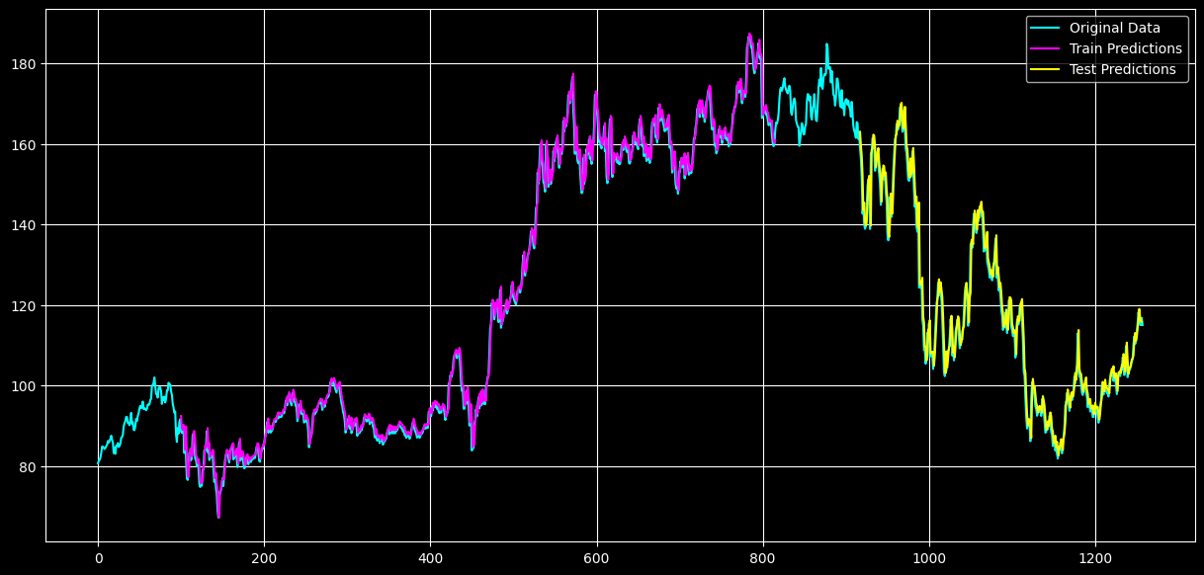
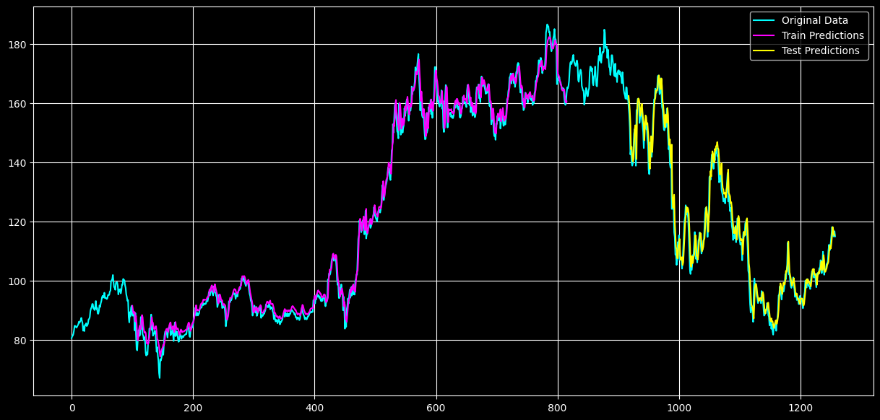
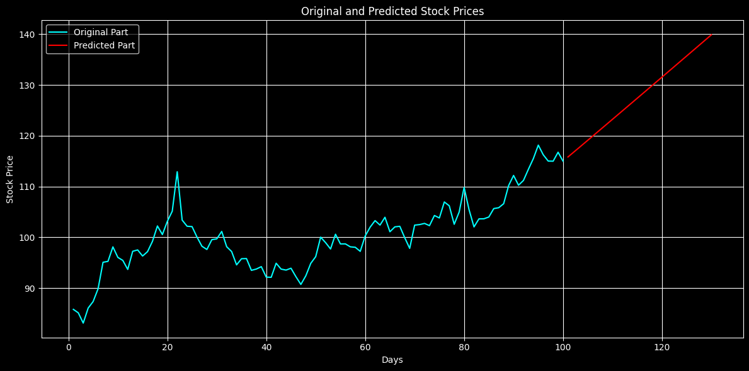
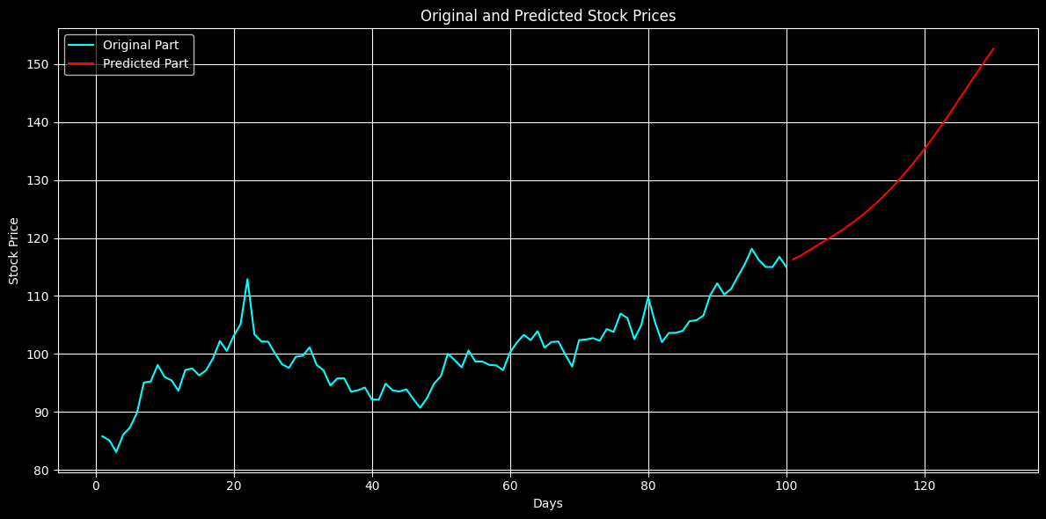
Model Comparison
Mamba model
LSTM model

Slide 9
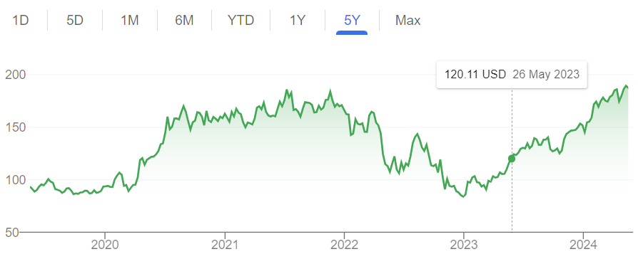
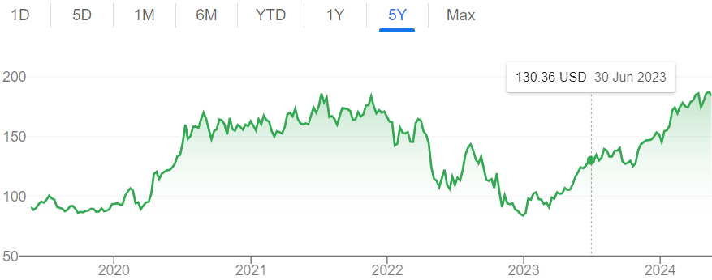
Real evolution

Slide 10
Results and Conclusion
Mamba Model:
Test Results (10 epochs):
Test RMSE: 0.0323
Model Complexity:
Number of parameters: 98,112
Conclusions:
Achieves a test loss with a relatively low RMSE on both train and test data.
The model has a moderate number of parameters, suggesting a balance between complexity and performance.
LSTM Model:
Test Results (10 epochs):
Test RMSE: 0.1939
Model Complexity:
Number of parameters: 173,851
Conclusions:
Demonstrates a higher training loss compared to the Mamba model but achieves a similar test RMSE.
The LSTM model has a higher number of parameters, indicating higher complexity.
Overall Conclusion:
Mamba model exhibiting slightly better performance in terms of loss and RMSE, despite having fewer parameters.
The Mamba model could be favored for its efficient use of parameters and comparable performance, suggesting it as a more resource-efficient option for stock market prediction tasks.

Slide 11
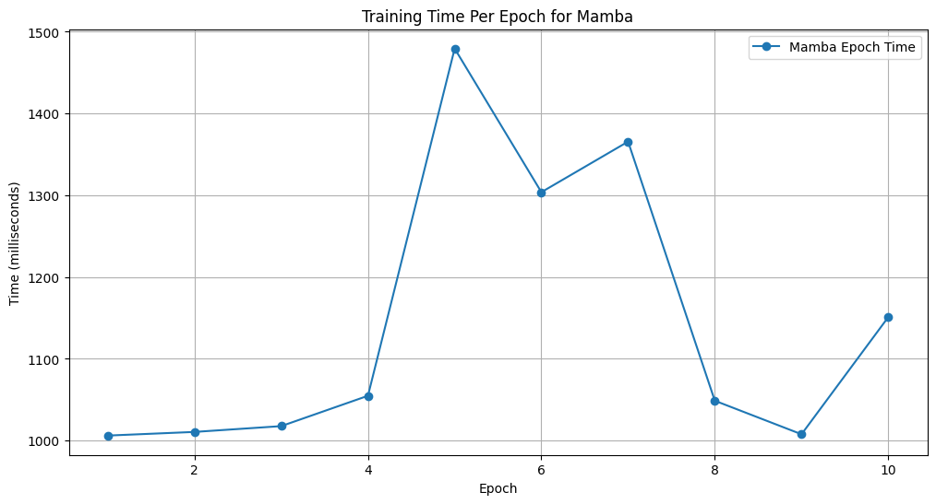
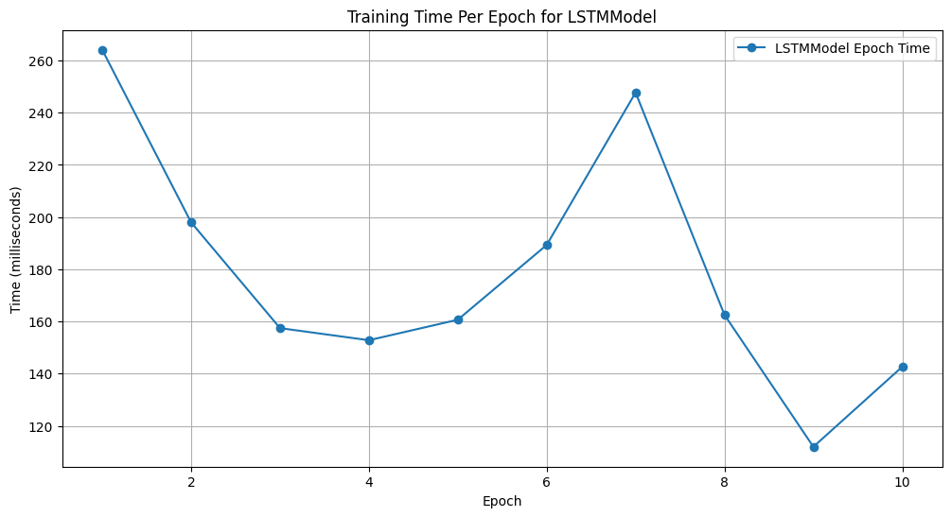
Results and Conclusion- Train Times
Mamba Model:
LSTM Model:
The Mamba model exhibited varying epoch times during training, ranging from around 1000 milliseconds to nearly 1500 milliseconds across different epochs.
The LSTM model displayed relatively stable epoch times, averaging around 200 milliseconds per epoch throughout training.

Slide 12
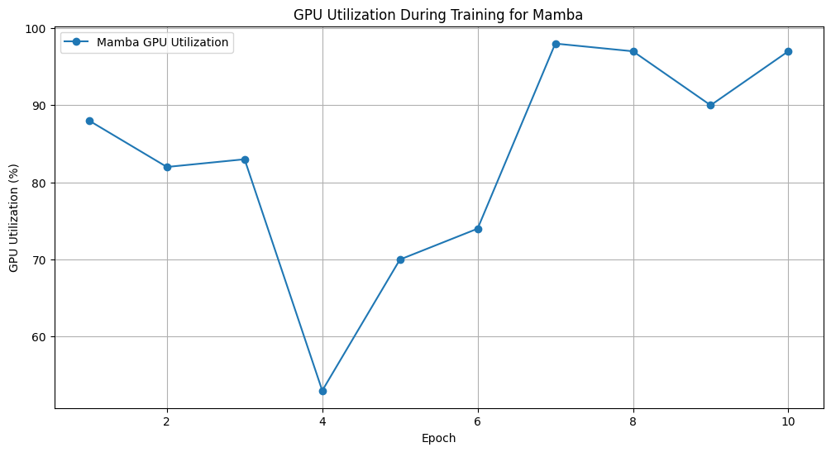
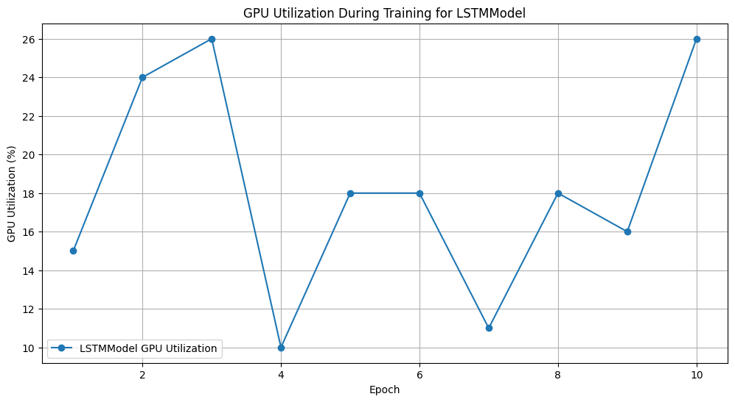
Results and Conclusion- GPU UTILIZATION
Mamba Model:
LSTM Model:
For Mamba The GPU utilization fluctuated between 44% and 97%, with higher GPU utilization potentially indicating more intensive computations during certain epochs.
The GPU utilization was lower compared to the Mamba model, peaking at 26% but remaining relatively stable during training.

Slide 13
Conclusions
The fluctuations in epoch times and GPU utilizations for the Mamba model might indicate varying complexity in computations, potentially addressing intricate data patterns more comprehensively.
With a smaller parameter count, the Mamba model may have a reduced capacity to memorize noise or overfit the training data, potentially leading to better generalization on unseen data.
The LSTM model's higher parameter count (173,851) may have allowed it to capture more nuanced patterns but potentially at the cost of increased complexity and risks of overfitting.
The runtime data indicates that the Mamba model engaged in more intensive computations, leading to better predictive accuracy compared to the LSTM model.
The Mamba model, with its novel architecture featuring selective scanning (involves performing computations in parallel by selectively processing different segments of input data) and residual blocks (aid in training effectively by mitigating optimization challenges associated with the deep architecture), demonstrated better efficiency in capturing the underlying patterns in the stock data, leading to superior predictive accuracy.

Slide 14
Conclusions
The comparison between the Mamba and LSTM models implies that having more parameters does not always guarantee better performance.
The Mamba model's efficient utilization with fewer parameters led to more accurate predictions, highlighting the importance of model design, architecture, and optimization in achieving successful outcomes in predictive tasks.
By correlating the number of parameters in each model to the results obtained, you can infer how model complexity and capacity for generalization influenced their respective performances in the stock prediction task.

Slide 15

THANK YOU
Avi Giuili
ID: 330190950 , Email : avigiuili@mail.tau.ac.il
Omer Bahary
ID : 315329946 , Email : omerbahary@mail.tau.ac.il
Almog Cohen ID : 308223585, Email : almogc1@mail.tau.ac.il

